Slide 1
Chapters 2, 3, & 4: Legal and regulatory foundations
Real Estate Principles: A Value Approach
Ling and Archer

Slide 2
Outline
RE as rights
Deeds
Public (county) records
Co-ownership
Land use regulations
Property taxes

Slide 3
A few words before we begin...
This is not a course about RE law. So, we combine the 3 chapters together.
We only address the most important aspects of RE legal concepts here.
Additional legal terms and concepts will show up in later chapters on a need-to-know basis.
Read the three chapters for more info.

Slide 4
RE as rights
Real estate (real property) is rights to land and its permanent structures. These rights are referred to as interests. This bundle of rights (interests) may include (1) exclusive possession, (2) use (enjoyment), and (3) disposition. The value of real estate tends to vary with the completeness of the interest.
Rights are non-revocable, enduring claims or demands that our government is obligated to enforce so long as the owner does not abandon or neglect the property..
Notes:
The legal concept of adverse possession.

Slide 5
An example
Suppose that you own a building lot with posting signs in Homer, Alaska. A homeless person put a tent on your land recently. Because you have rights to this lot, you can expect law enforcement to try to reclaim it once law enforcement is notified about this violation of rights. These rights are non-revocable in the sense that they cannot be canceled, ignored, or lessened by any other private citizen. These rights are enduring and do not fade away with time. The government is obligated to defend these rights for subsequent generations of yours as well.

Slide 6
Defiant trespassing
Defiant trespass occurs when a person not licensed or privileged to do so, enters or remains in any place as to which notice against trespass is clearly provided.
Example of a state law on defiant trespass: in New Jersey, defiant trespass can occur in a property normally open to public if notice against trespass is given by:
a. Actual communication to the actor
b. Posting in a manner prescribed by law or reasonably likely to come to the attention of intruders
c. Fencing or other enclosure manifestly designed to exclude intruders.

Slide 7
Estates
RE interests/rights can be possessory or non-possessory.
Interests that include possession are called estates.
2 categories: (1) ownership estates or titled interests (freeholds): more substantial (complete) estates; indefinite in length, (2) non-ownership estates (leaseholds): limited in time; no meaningful right of disposition; like leasing.

Slide 8
Pricing implication
“A 12th-floor leasehold apartment at the Prince Kuhio Street building with 200 square feet is priced at $75,000. Nearby, a fee-simple (freehold) eighth-floor unit with 206 square feet in the Kuhio Village 1 building is listed at $135,000 — a $60,000 price difference.”
Honoluluadvertizer.com, 2016

Slide 9
Private ownership in China
A land lease of up to 70 years for residential purposes.

Slide 10
Examples of non-possessory interests, i.e., non-estates
Easement: a right that the owner(s) of another property may have to use one’s land for a specific and limited purpose. Example: the access to a view.
Restrictive covenants: they impose limits on the use of land. Example: no RV’s parked in view of the street.
Lien: an interest in real property that serves as security (collateral) for an obligation, say a debt obligation. Example: Mr. Miller bought a house and borrowed money from BofA. That is, he granted a mortgage claim to BofA. The mortgage lien is an interest in property as security for a debt. BofA owns the mortgage lien.

Slide 11
Deeds
Deeds are usually used to convey interests in real estate.
A deed is a special form of written contract used to convey a permanent interest in real property.
Note that the legal tradition recognizes certain words and phrases as signals of various legal meanings. Having services from a legal professional can be important and essential.

Slide 12
General warranty deed
General warranty deeds: a type of deeds that contains the full set of legal promises (warranties) that the grantor (seller) can make.
The grantor (seller) warrants that the title he/she conveys to the property is free and clear of all encumbrances, i.e., anything that affects or limits the title, other than those listed in the deed.
This is the “highest-quality” deed.

Slide 13
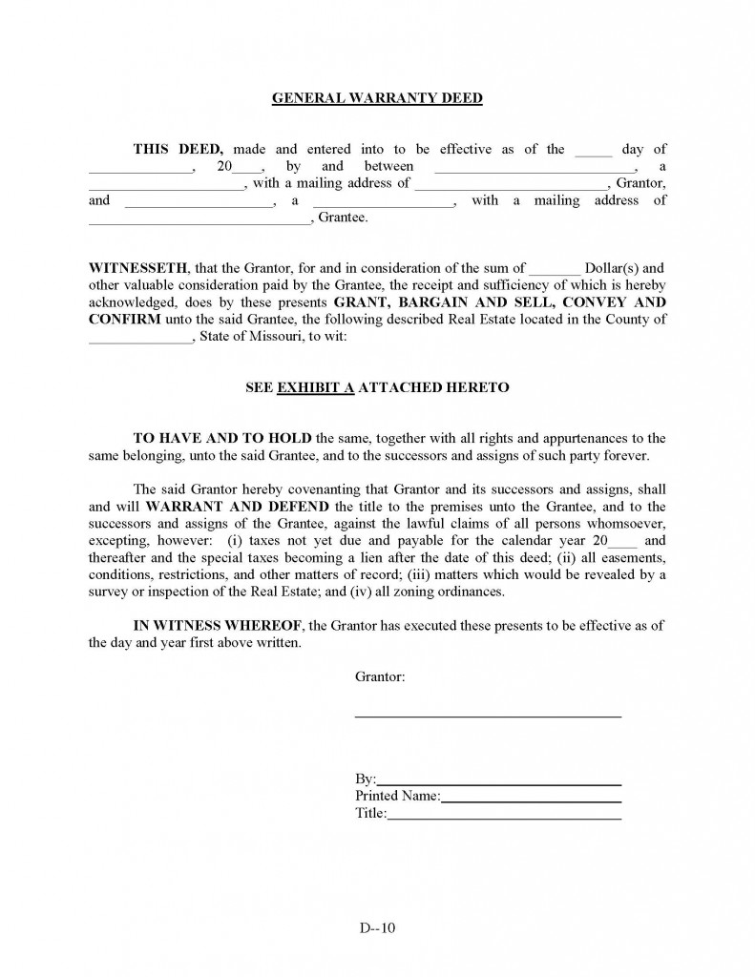
A sample

Slide 14
Special warranty deed
Special warranty deed: it is similar to the general warranty deed, except that it limits the time of the covenant of encumbrances (liens, easements, etc.) to the grantor’s ownership.
Covenants: legally binding promises.
It asserts nothing about encumbrances from previous owners.
This is generally regarded as a “quality” deed.

Slide 15
Deed of bargain and sale
Deed of bargain and sale: has none of the covenants of a warranty deed.
The deed is commonly used by businesses to convey property.
The deed still appears to imply claim to ownership.

Slide 16
Quitclaim deed
Quitclaim deed: has none of the covenants of a warranty deed.
The deed implies no claim to title, only to convey what interest the grantor actually has.
The deed provides a questionable conveyance of title, i.e., a non-fully-marketable title.
The deed is clouded by disputes and events, e.g., a divorce proceeding.

Slide 17
Buying a divorcing home
Often, one spouse is anxious to sell, while the other tries to sabotage the deal, either out of spite or an unwillingness to end the marriage.
Charles Vallis, a Massachusetts-based agent for discount broker Redfin, had a recent sale in which his buyers went to contract and had a closing date, but then the wife in the divorce disappeared.
"She was nowhere to be found for the last few days before closing.”
Source: Chicago Tribune, 2011.

Slide 18
Judicial and trustee’s deed
The judicial deed is one issued as a result of court-ordered proceedings, e.g., a deed via foreclosure sale.
The trustee’s deed is issued by the trustee in a court-supervised disposition of property, e.g., a guardian of a minor or a bankruptcy trustee.
The quality of the deed depends on the completeness of proceedings.

Slide 19
Title
No single document, including deed, can absolutely confirm title.
Title: a collection of evidence indicating a particular person(s) as holder/owner of the RE.

Slide 20
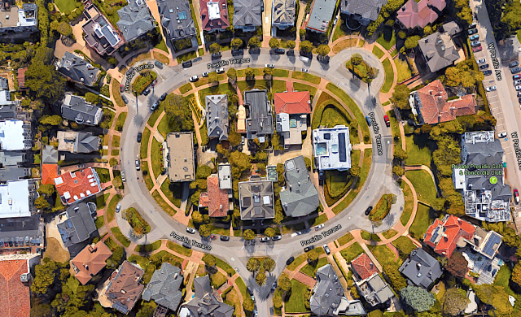
The title/ownership of a private street
An Asian couple bought the private street in a city auction because of <$1,000 unpaid property tax accumulated over 3 decades. The street was owned by a gated communities of 35 mansions in San Francisco. The homeowners were not aware of the unpaid tax and the auction because they did not update their accountant’s address. The homeowners sued the city and the Asian couple. Source: HuffPost, 2017.

Slide 21
Part II: the completeness of proceedings
House Speaker Nancy Pelosi, Sen. Diane Feinstein and former San Francisco Mayor Joseph Alioto all used to live among the 36 multi-million dollar homes.
The City of San Francisco has formally rescinded the sale of the property.
The couple is suing the city to get back ownership of the exclusive, gated street they purchased from under the wealthy homeowners of Presidio Terrace.
They have heard from the city, however: “The only thing they did is send me the new tax bill.”
They paid it right away.
Source: The Mercury News, 01/10/2018

Slide 22
Title assurance
The worst thing that can happen to a RE buyer is that the title is not good/marketable.
A warranty from the seller as part of the deed can only be used to improve the quality of title.
Two main forms of “evidence of title:” (1) a very careful search of title history to ensure the quality of the title, along with an attorney’s opinion, and (2) title insurance.

Slide 23
Title search, I
(1) Priority of real property private claims is by chronology of recording.
(2) The rights in real property are enduring.
Implication of (1) and (2): the only way to be certain what rights are obtainable, and from whom, is to be able to account for the complete legal history of the property.

Slide 24
Title search, II
The goal of title search is to construct a chain (history) of title from the earliest record time to the current owner.
If no breaks in this chain are discovered, then a complete chain is established.
A title search produces a title abstract that is a chronological summary of relevant documents.
The grantor (seller) is frequently asked to demonstrate a good title in order to complete the sale by presenting either (1) title abstract and attorney’s opinion, or (2) title insurance commitment.

Slide 25
Title insurance
2 types of title insurance policies: (1) the owner’s policy insures the interests of a new property owner, (2) the mortgagee’s (lender’s) policy insures the interests of the mortgagee.
Title insurance is required for any mortgage that is traded in the secondary mortgage market.

Slide 26
Tribal land claims and questionable titles
Among those who’ve felt such pain is Daniel Gates, a seventh-generation Chittenango (NY) farmer. By 1999, he had been trying for two years to sell his 800-acre farm in order to pay off his debts and retire, but he could find no buyers, even at a cut price.
As real-estate broker Michael Gaiser explained to a reporter, selling land in the Indian claim area had become “a nightmare,” because the difficulty and delay in getting title insurance slow down transactions and spook potential buyers.
Source: City Journal

Slide 27
Land back
Land Back is a campaign that seeks to establish political and economic control to indigenous people over land that had historically belonged to them prior to colonization.
The Wiyot people have lived for thousands of years on California’s northern coast. In 2004 the Eureka City Council transferred land back to the Wiyot tribe, to add to land the Wiyot had purchased. The council transferred another 60 acres in 2006.
The Mashpee Wampanoag have lived in Massachusetts and eastern Rhode Island for thousands of years. In 2007, about 300 acres of Massachusetts land was put into trust as a reservation for the tribe.
Source: Wikipedia

Slide 28
Public records, I
Doctrine of constructive notice: a person cannot be bound by claims he/she has no means of knowing.
This doctrine requires documents conveying an interest in real property to be placed in the (county) public records.
Once in the public records, the document is bonding on everyone, whether or not they make an effort to learn of it.
Implication: when a grantee receives a deed, it is important to record it asap since priority of real property private claims is by chronology of recording.

Slide 29
Faulty foreclosure
A Massachusetts man who bought a home in a faulty foreclosure sale didn’t have the right to bring a court case over the property because he isn’t the owner, the state’s high court ruled.
The Supreme Judicial Court, which in January found that banks can’t foreclose on a house if they don’t own the mortgage, went one step further in a closely watched case and said a sale after that foreclosure doesn’t transfer the property. Therefore, the buyer couldn’t bring his court action against a previous owner, the court ruled.
U.S. Bankcorp clouded home titles through sloppy transferring of mortgages.
Source: Bloomberg, 2011

Slide 30
Public records, II
The public records cannot assure complete knowledge of real property interests because some conveyances occur without a deed.
Example: a subdivision map may show “implied easements” such as bike paths or footpaths that are not spelled out in the deed.
Implication: property should never be acquired until it has been inspected.

Slide 31
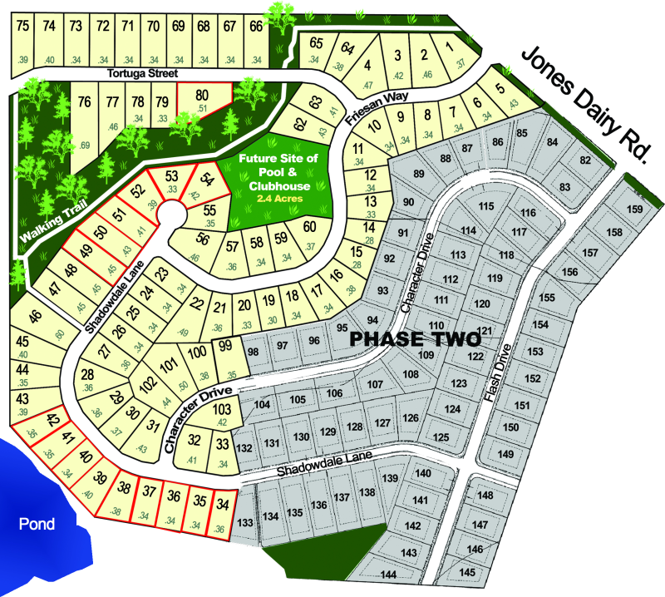
A subdivision map

Slide 32
Co-ownership
Real estate is often owned by a group of persons either directly or indirectly.
Indirect co-ownership via public markets, e.g., real estate investment trusts (REITs), is becoming popular.

Slide 33
One form of direct co-ownership
Condominium: a form of ownership combining single person ownership with tenancy in common.
The owner holds a fee simple interest (freeholds) to a certain space, such as an apartment.
Joint with this estate, the owner is a tenant in common in the community elements, such as elevators, driveways, swimming pools, of the property. That is, no one can use these elements in a way that preempts the ability of the other owners to similarly enjoy them.

Slide 34
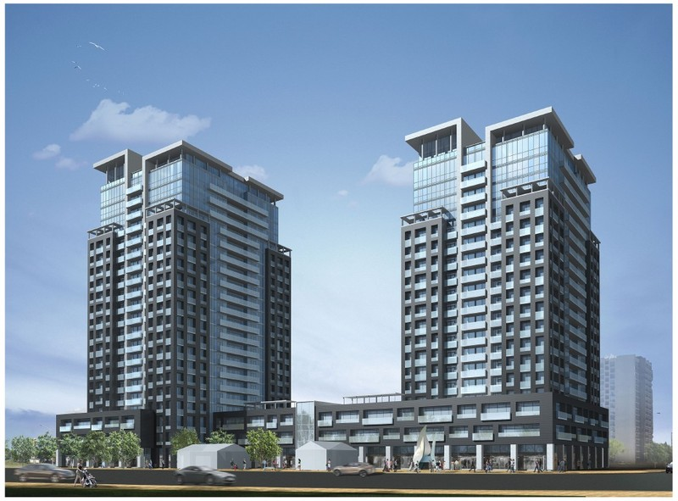
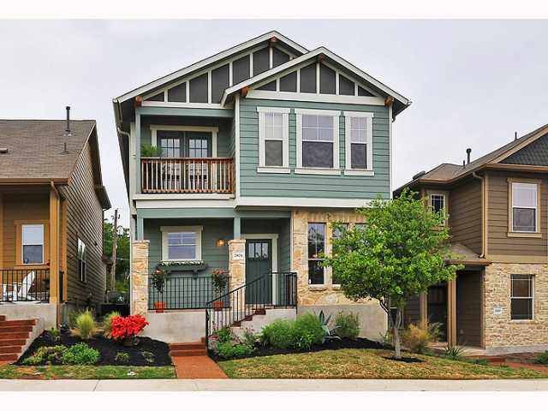
Examples of condos

Slide 35
Land use regulations
The usual land use regulations include at least (1) building codes, (2) zoning, and (3) subdivision regulations.

Slide 36
Building codes
The earliest use of policy power to regulate land use.
Set standards for many aspects of construction: structural strength and integrity, fire safety (Chicago fire of 1871), safety of electrical systems, gas lines, fire alarm systems, access to air and sunlight, emergency exits, etc.

Slide 37
Zoning ordinance elements
A list of land use categories, e.g., single family residential, multi-family residential, commercial, and industrial.
Minimum front, rear, and side setback requirements from the boundaries of a lot.
Building bulk limits, including size, height, maximum floor/area ratio (FAR: total building square footage to the square footage of the land), etc.
Minimum lot dimensions: depth and width.
A zoning board appointed to oversee the administration and to make rezoning recommendations.

Slide 38
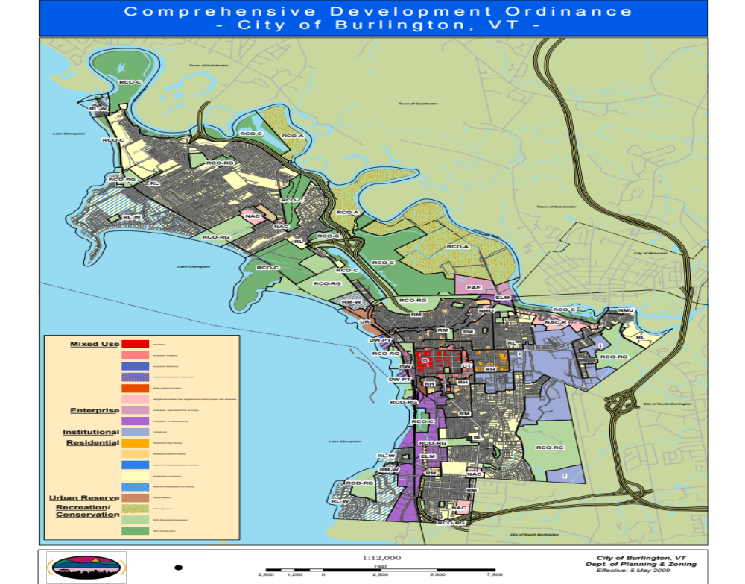

Slide 39
FAR and corruption
The ongoing corruption investigation into Ko Wen-je, the founder and leader of the Taiwan People’s Party (TPP) and a candidate in Taiwan’s most recent presidential election, has sent shockwaves through Taiwan.
The corruption investigation into Ko centers on whether he used his power as Taipei mayor to increase the floor area ratio (the ratio of a building’s total floor area to the size of the parcel of land it occupies) of the Core Pacific City redevelopment project from 392 percent to 840 percent. Such a change would have enabled developers to reap billions in additional profit
Source: Council on Foreign relations, 09/2024.

Slide 40

Core Pacific City redevelopment

Slide 41
Affordable housing regulations
The City of West Hollywood, California…has required developers to either set aside 20% of the units to be sold at below-market rates or to pay a fee that will be used to subsidize housing for people with low or moderate incomes.
Jonathan and Shelah Lehrer-Graiwer applied for a permit to build the 11-unit condo at 616 N. Croft Ave. and were required to pay a fee of $540,000 to subsidize affordable housing elsewhere. They objected.
The Supreme Court said Monday it has turned down a property rights case from West Hollywood that challenged a California requirement that developers subsidize the creation of affordable housing.
Source: AP, 10/30/2017.

Slide 42
Subdivision regulations
The developer will present a site plan in a public hearing.
Local subdivision regulations provide guidelines about layout of lots, open spaces, utilities, recreation, and access to service, water, drainage, sewer, etc.

Slide 43
Other land use controls
Planned unit development (PUD): traditional land use regulations, e.g., setback requirements are allowed to vary in some areas in exchange for larger areas of open space, nature preservation, etc.
Performance standards: e.g., rather than prohibiting industrial use in a commercial area, the use may be allowed if emission and noise is minimum.
Impact fees: if development imposes externality costs on the community at large, the developer may pay an impact fee. As of 02/2022, the City of Burlington charges $7,800 for a 2800 sqft home.
Growth restriction: in Arizona a developer needs to secure 100-year water source before he/she can work on the development.

Slide 45
Eminent domain
Eminent domain: the right of government to acquire private property, without the owner’s consent, for public use in exchange for just compensation. The legal procedure involved is called condemnation.
The concept of public use has been expanded by the courts to include instances where there is a clear public benefit or public purpose.

Slide 46
London’s housing crisis
London’s price to income ratio = 33.5.
“To solve London's housing crisis the government must arm the city's mayor with tough new powers to seize under-used commercial property from its owners for a "reasonable, but not excessive" fee so homes can be built on the land, says a report by the Policy Exchange think tank.”
2/17/2016, International Business Times.

Slide 47
Private property rights
Officials from two coronavirus-stricken cities, Guangzhou and Shenzhen, in southern China have been authorized to confiscate private property in an effort to combat the outbreak that has pushed the country’s health system to its limits.
The government can also ask relevant organizations to produce or provide disease control equipment or daily supplies, according to the notice. It noted that officials carrying out such measures should compensate parties accordingly and return the materials if possible.
Source: Epoch Times, 02/11/2020

Slide 48
A local possible use of eminent domain
“The South Burlington City Council is considering using the city’s power of eminent domain to construct a portion of shared-use path (for both pedestrians and bicyclists)…from Old Cross Road to Sadie Lane on the east side of Dorset Street.”
“But some property owners say the use of eminent domain for a shared-use path doesn’t cut it.”
A property owner argues that “this is not a bridge or interstate overpass. It’s not a public need.”
Source: The Other Paper, 10/2025.

Slide 49
Property taxes, I
Counties, cities, school districts, urban service districts, transit authorities, and water management districts may levy real property taxes.
In stead of percentages, property tax rates are usually stated in mills, i.e., dollars per $1,000 of value.
Example: A tax rate of 2% means $20 of tax per $1,000 of value. In terms of millage rate, this would be 20 mills.

Slide 50
Property taxes, II
The (county) tax assessor appraises all taxable properties in a jurisdiction for property tax assessment.
The value for taxation, called assessed value, is a function of market value.
Some states specified the assessed value as a certain percentage, say 90%, of market values.

Slide 51
Property taxes, III
Example: Suppose that a property appraised for $150,000 in a state that requires tax assessment to be 90% of market value. Assume that the owner qualified for a $25,000 homestead exemption.
Taxable value = assessed value – applicable exemptions = ($150,000 × 0.9) – $25,000 = $110,000.
Suppose that the total millage rate is 21.69 mills.
Property tax = 110 × $21.69 = $2,385.9.
The effective tax rate = $2,385.9/$150,000 = 1.59%.

Slide 52
South Burlington homestead
Property owners whose dwellings meet the definition of a Vermont homestead (i.e., you are a Vermont resident, and you own and occupy a homestead as your domicile as of April 1) must file a Homestead Declaration annually by April 15.
The education property tax rate levied on nonresidential property differs from the rate levied on homestead property.
Tax Rate for the 2020/2021 year-
Homestead Tax Rate- $2.1857
Non-Homestead Tax Rate- $2.3647

Slide 53
Median property tax vs. median home value
State %Value Rank
Hawaii 0.29% 50
Louisiana 0.62% 40
New Jersey 2.46% 1
Vermont 1.89% 6
MA 1.19% 19
New York 1.73% 7
California 0.81% 34
Florida 0.89% 28
Texas 1.90% 5
Source: U.S. Census Bureau, 2022

Slide 54
Transfer tax
San Francisco will be the first city in the nation to offer free community college to all residents (currently $46 per credit hour).
Transfer tax: The city will pay for it by taxes on properties selling for more than $5 million.
Transfer tax is essentially a sales tax on properties.
The tax starts at 2.25% and goes up to 3% for properties worth at least $25 million.
This tax in VT is progressive and is about 1% for a typical home in Chittenden county.
Source: CNN, 2017

